Slide 1

MECHANICS
IB PHYSICS

Slide 2
Kinematic Concepts
Scalar & Vector
Motion & Rest
Distance & Displacement
Speed & Velocity
Acceleration

Slide 3
Scalar
Scalar quantities are the Physical quantities which is complete with a magnitude alone.
Mass, Temperature, Energy, Work, Pressure ………
The mass of my body is 60 kg means my body is made up of matter 60kg. It doesn’t need any more explanation.

Slide 4
Vector
Vector quantity is the one which need a direction for completing its existence.
Velocity, Force/ Weight, Acceleration….
My weight is 600 N means, I am pulled towards earth with a force of 600N. It is not complete unless it is specified towards Earth.

Slide 5
REST & MOTION
Rest- An object is said to at rest if it is not varying its position with respect to time.
Motion- An object is said to be under motion if it changes its position with respect to time.
Both motion and rest are comparative.
A table in my living room at rest with respect to Earth while, under motion with respect to Sun.

Slide 6
Distance & Displacement
Displacement- Displacement is the difference in position of the object. It is the straight line distance between the initial and final positions of an object. It is a vector quantity.
Distance- Distance is the length of the path followed by the object. It is a scalar quantity.

Slide 7
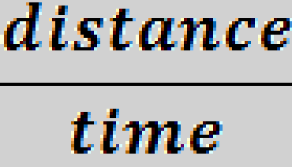
Speed
Speed is the rate of change of distance
Or the distance covered per unit time
Speed is the total distance (s) covered in total time (t)
Speed =
SI Unit- ms⁻¹

Slide 8


Velocity
Is the rate of change of displacement
Is a measured speed in a given direction
It tells us not only the speed of the object but also the direction
It is a vector quantity.
Velocity = =

Slide 9
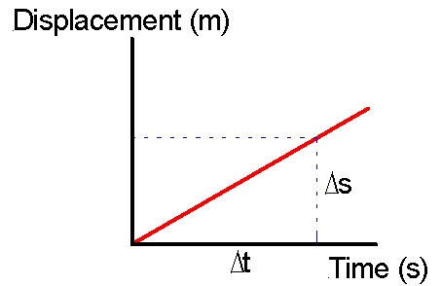

Slide 10

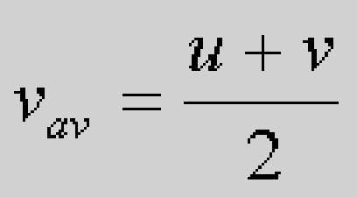
Average speed & Average velocity
Average speed =
Average velocity = total displacement (s)
total time (t)
If u is the initial velocity & v final velocity of the object

Slide 11
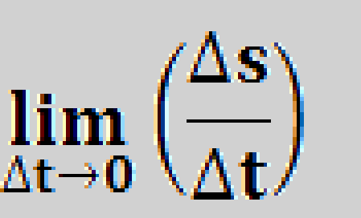
Instantaneous Velocity
It is the average velocity obtained during an interval of time which is very very small.
The slope of the tangent to the graph of the position versus time is velocity.
v=

Slide 12
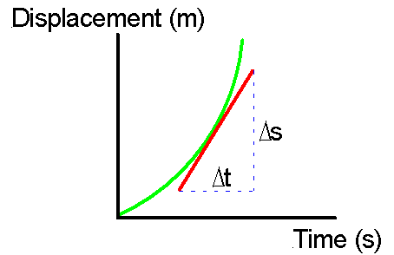
Instantaneous velocity

Slide 13
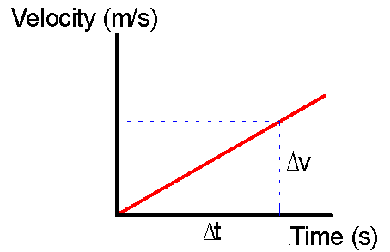
Velocity time graph

Slide 14

Acceleration
Is the rate of change of velocity.
Acceleration= ( v-u)/t
SI unit is ms⁻²

Slide 15
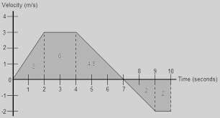
Change in position from Velocity Vs Time graph
The area under the curve in a velocity versus time graph is the change in position

Slide 16
Answer to above graph:
The total distance travelled by the object is the sum of all the distances it travelled during the time interval. In the first two seconds it travelled 3 m. Then it travelled 6 m in the next two seconds. Then over the next five seconds, the object moved 4.5 m, . so the total distance is 3 +6 + 4.5 =13.5 m.
Down the graph it travelled -4m
The displacement of the object is 13.5-4 = 9.5m

Slide 17
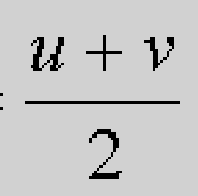
Equations of motion
Change in position = Area under the curve
∆s = Average velocity x t
∆s = t ,substitute v=u + at
∆s = ut +1/2 at²

Slide 18
Continued…..
∆s = Average velocity x t
Substitute for t=(v-u)/a
∆s = (V² –u² ) /2a

Slide 19




Equations of Motion SUVAT(can only be applied when acceleration is constant)
u + v 2
s =
t
v = u + at
v² = u² + 2as
s = ut + ½at²

Slide 20
Projectile motion
A projectile is an object that has been given an initial velocity by some sort of short-lived force, and then moves through the air under the influence of gravity.
•Baseballs, stones, or bullets are all examples of projectiles.

Slide 21
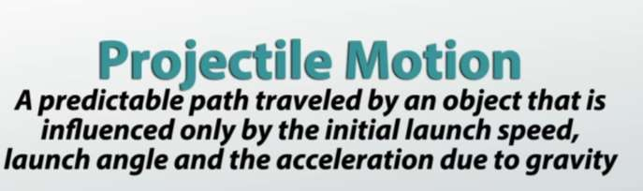
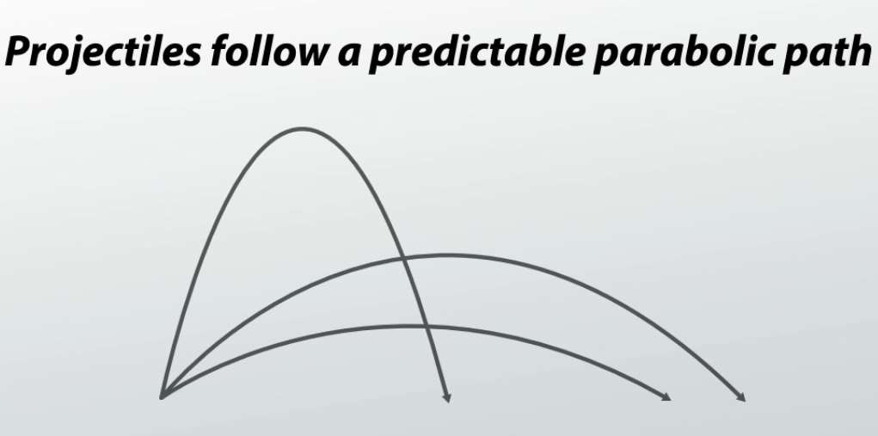

Slide 22
Some examples of projectiles include…
a baseball that has been pitched, batted, or thrown
a bullet the instant it exits the barrel of a gun or rifle
a bus driven off an uncompleted bridge
a moving airplane in the air with its engines and wings disabled
a runner in mid stride (since they momentarily lose contact with the ground)
the space shuttle or any other spacecraft after main engine cut off (MECO)

Slide 23
Force on a projectile
The force of primary importance acting on a projectile is gravity.
The kinematic equations for a simple projectile are those of an object travelling with…constant horizontal velocity and constant vertical acceleration.

Slide 24
Kinematic Equations are now…
Equation | Horizontal |  |  | Vertical
acceleration | a_{x} | = 0 | a_{y} | = −g
velocity-time | v_{x} | = v₀x | v_{y} | = v₀y − gt
displacement-time | x | = x₀ + v₀xt | y | = y₀ + v₀yt − ½gt²
velocity- displacement |  |  | _{v} 2 y | = v₀y² − 2g(y − y₀ | )

Slide 25
Horizontal Range
The horizontal distance travelled by a projectile is called its range.
A projectile launched on level ground with an initial speed v₀ at an angle θ above the horizontal…
  will have the same range as a projectile launched with an initial speed v₀ at 90° − θ. (Identical projectiles launched at complementary angles have the same range.)
  will have a maximum range when θ = 45°.
•

Slide 26
End of the Chapter
THANK YOU

